Slide 1
The Oracle Multitenant Architecture
DBA team

Slide 2
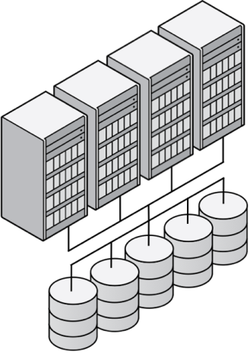
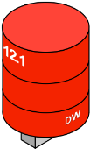
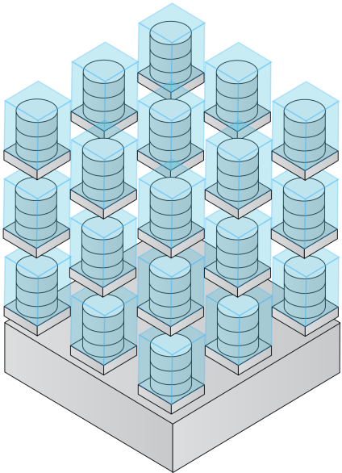
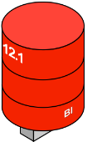

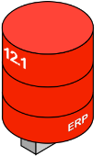


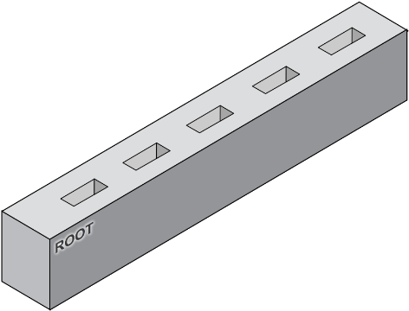


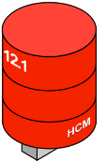

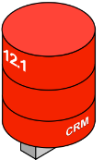
Private Database Cloud Architectures
Oracle Database 12c
Virtual Machines
Dedicated Databases
Pluggable Databases
share servers
share servers and OS
share servers, OS and database
Increasing Consolidation

Slide 3



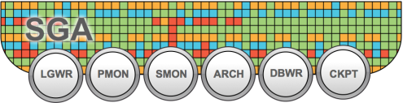
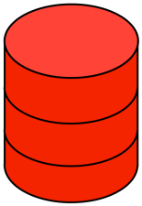
Oracle RAC support for Oracle Multitenant
RAC Database, non-CDB
CRM Reporting
CRM Reporting
Services
Node 1
Node 2
Node 1
RAC Instance 1
RAC Instance 2
Services
CRM
North
CRM
South
RAC Instance 1
CRM

Slide 4















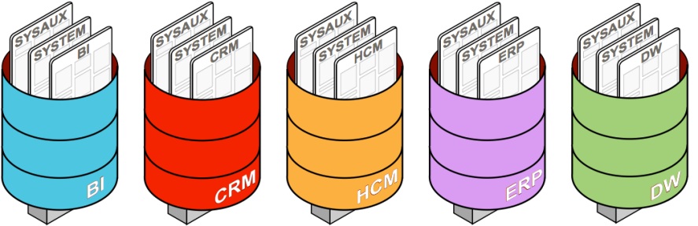

Oracle RAC support for Oracle Multitenant
Flexible Consolidation Model – In Detail
Node1
Node2
Services
CDB Instance 1
CDB Instance 3
Single SGA per
Root/CDB Instance
Node3
ERP
Reporting
ERP
Batch
HCM
EMEA
HCM
Americas
CDB Instance 3
ERP
HCM
CDB

Slide 5
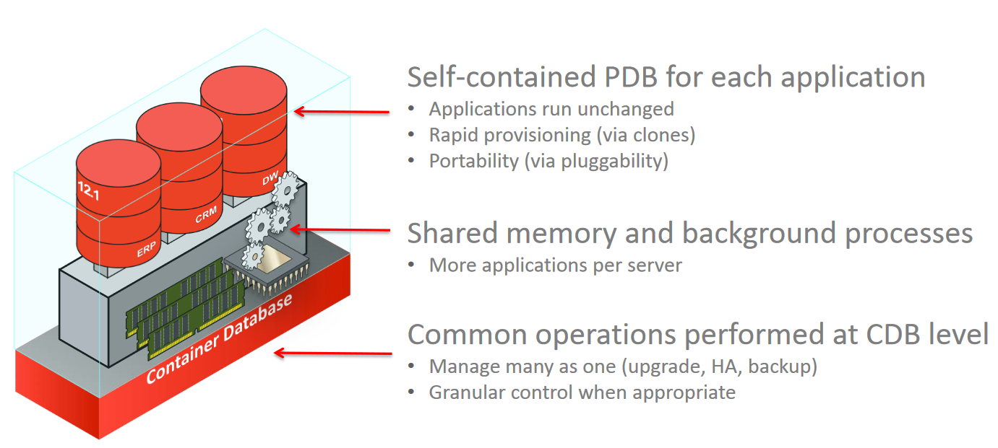
Container insight

Slide 6
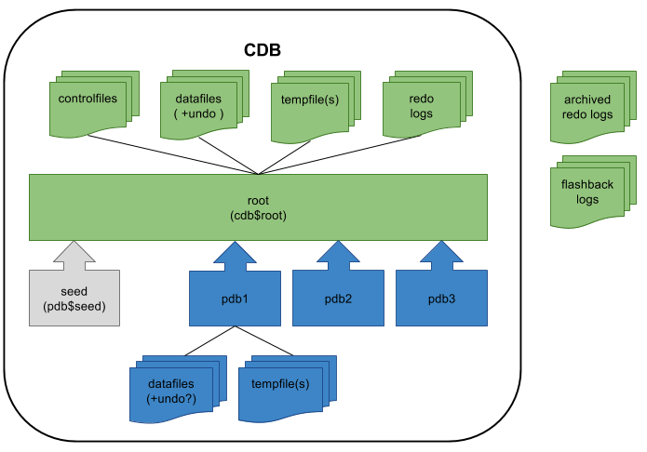
Container insight

Slide 7
Multitenant 12.2 vs schema consolidation
2014 2015 2016 2017
Multitenant 12.2 | Schema consolidation
License costs
No additional costs
PDB cloning is now possible also online
RMAN cloning is not possible
Flashback now possible on PDB level
Flashback on database level
AWR now available on PDB level
AWR on database level
Backup / Restore on PDB level with RMAN
Backup / Restore only with datapump
Changes for DB administration
Still conventional databases
Memory management on PDB level
Only limited resource manager

Slide 8
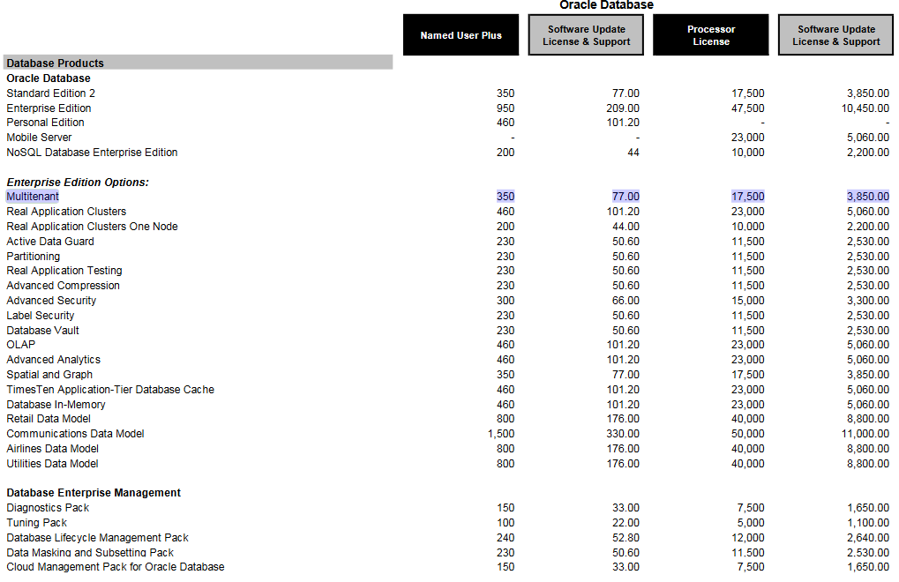
Multitenant 12.2 vs schema consolidation

Slide 9
Controlling PDB Resources
PDBs in 12.2
SGA/PGA size for a PDB can also be capped
SGA_TARGET
PGA_AGGREGATE_LIMIT
Per-PDB I/O Resource Management
Control IOPS and throughput for storage
New PDB parameters: MAX_IOPS, MAX_MBPS
Per-PDB Performance Profiles
More control of memory
General I/O resource management
Proper instance caging
Simplified resource management plans

Slide 10
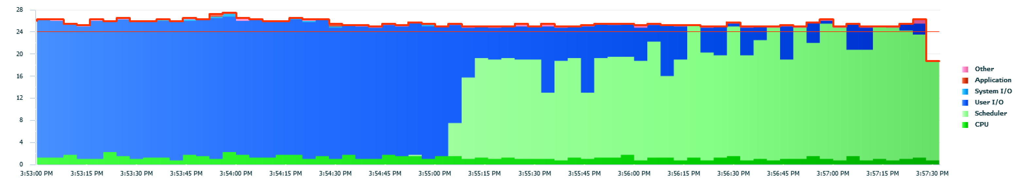
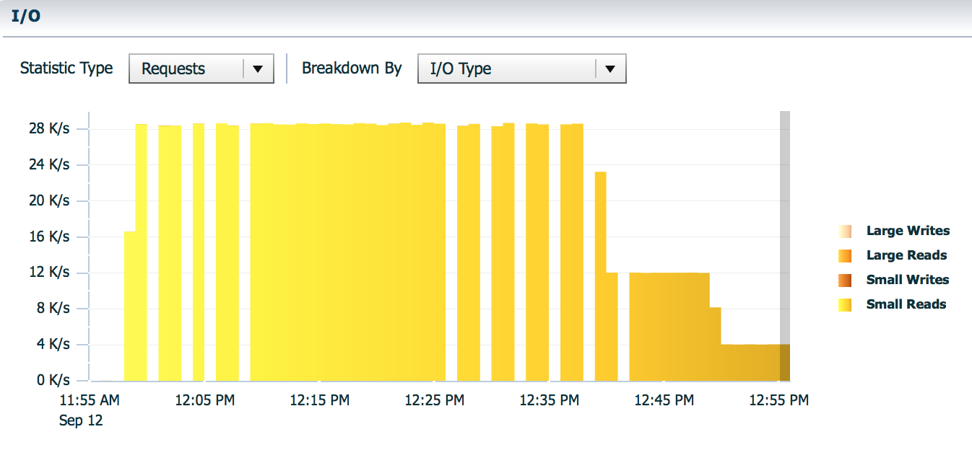
Per-PDB I/O Resource Management
Run SLOB
Set MAX_IOPS in PDB
alter system set max_iops=4000;
Check results in OEM
No
Limit
Caged!
No
Limit
Caged!

Slide 11
Per-PDB Performance Profiles
PDB profiles require 3 attributes
share – portion of resources allocated to the profile
utilization_limit – hard cap for resources (percentage-based)
parallel_server_limit – maximum percentage of parallel servers used by PDB
PDB Profile | shares | utilization_limit | parallel_server_limit
gold | 6 | 100 | 100
silver | 3 | 40 | 40
bronze | 1 | 10 | 10
default | 1 | 10 | 10
autotask | 1 | 60 | 60

Slide 12
Operation benefits and limitations

Slide 13
Operation benefits
In a large setup, it is common to see 20 or 30 different instances running in production environment.
With Pluggable Databases feature, We just have to do all this for ONE single instance ( or each PDB inside the CDB )
Setup - HA architecture (RAC - Data Guard)
Monitor
Backup
Upgrade
Patch
Optimize
Tuning

Slide 14
Operation limitations
Upgrade and patch apply at whole database
Make sure all applications are compatible
Or detach/attach PDB or avoid the upgrade
Dataguard :
Switchover at PDB level available at 18c
Have to use sso file (TDE)
Operator
Operation behavior will be different from before
Need time to read and understand the new architecture

